Slide 1
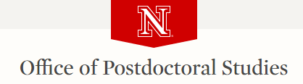
R for Research
Data Analysis using R
Day2: Advanced R
Baburao Kamble
University of Nebraska-Lincoln

Slide 2
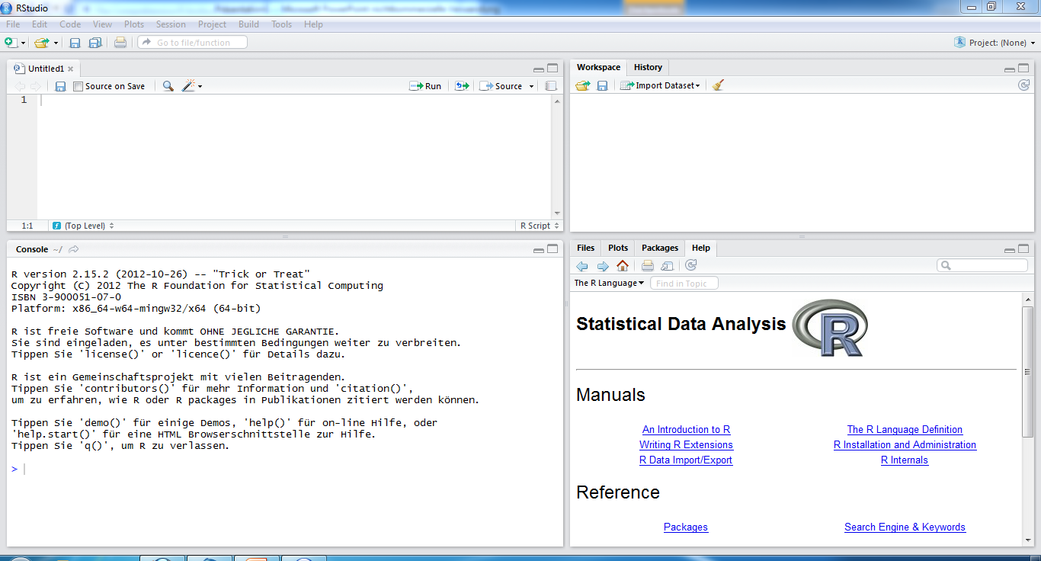
Working with RStudio
Select
Files
Plots
Packages (for advanced analyses)
Help
New R files
The command prompt

Slide 3
Agenda R
Advanced visualization (ggplot, lattice)
Descriptive Statistics
Regression Analysis
Time Series Data Analysis
Forecasting/Prediction
Workshop Material: http://snr.unl.edu/bkamble/r-pac/

Slide 4
Advanced Visualization
To present R graphics users with enough information to make an informed choice as to which graphics package best meets their needs
Simple or Advanced Visualization

Slide 5
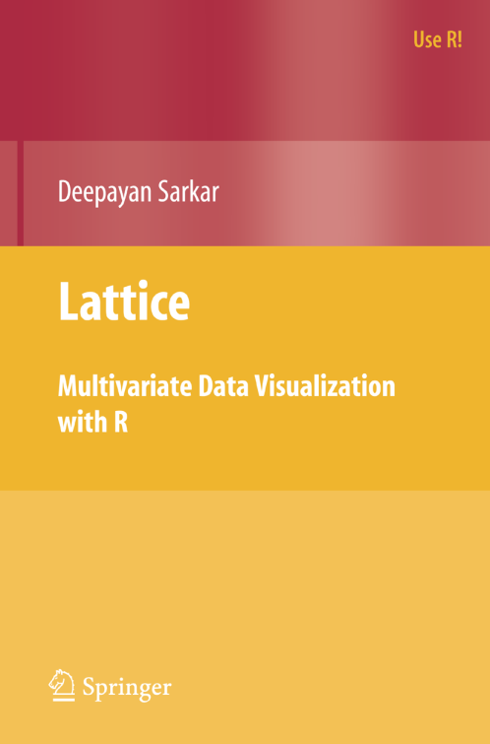
Overview of Lattice Graphics
One of the graphic systems of R (others include “Traditional” and “ggplot”)
An implementation of the S+ “Trellis” Graphics
Written by Deepayan Sarkar, Fred Hutchinson Cancer Research Center

Slide 6
List of Lattice Graphic Functions
Function | Description | Graph Type
xyplot | Scatter plot | Bivariate
histogram | Univariate histogram | Univariate
densityplot | Univariate density line plot | Univariate
barchart | Bar chart | Univariate
bwplot | Box and whisker plot | Bivariate
qq | Normal QQ plot | Univariate
dotplot | Label dot plot | Bivariate
cloud | 3D scatter plot | 3D
wireframe | 3D surface plot | 3D
splom | Scatter matrix plot | Data Frame
parallel | Multivariate parallel plot | Data Frame

Slide 7
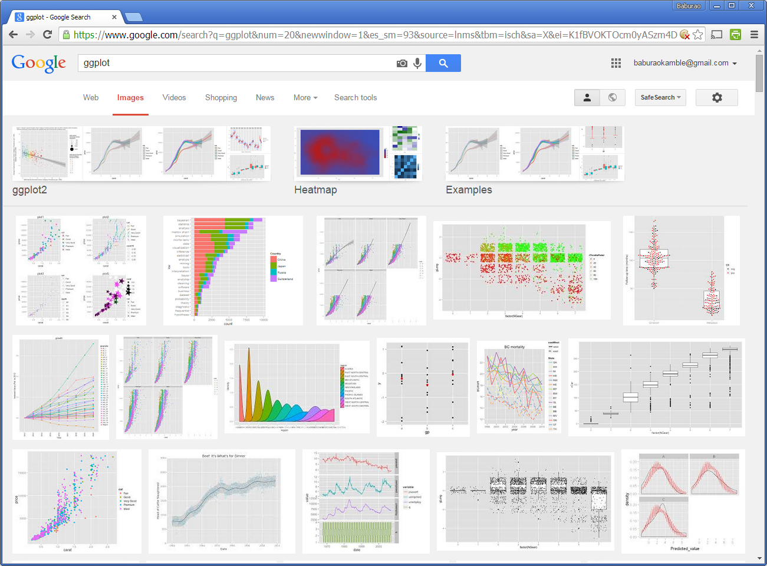
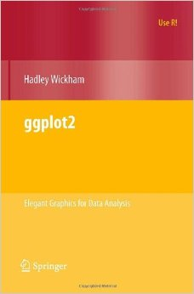
ggplot

Slide 8
Graphing in ggplot2
Library(ggplot2)
plotname <- ggplot(data, aes(x = xname, y = yname) + geom_point()
ggplot2 graphics work with layers
http://docs.ggplot2.org/current/

Slide 9
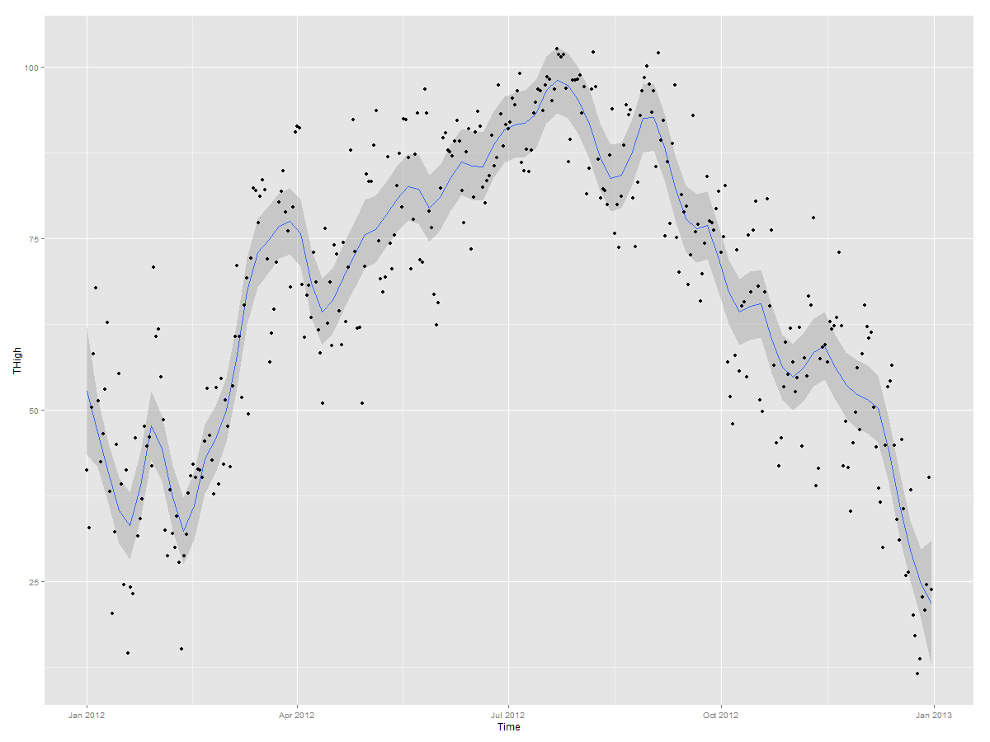
ggplot demo
Adv_Visualization.R

Slide 10
Descriptive Statistics
Quantitatively describing the main features of a collection of information
Descriptive statistics shows or summarize data in a meaningful way such that, for example, patterns might emerge from the data
Mean
Mode
Median
Standard deviation
DescriptiveStatistics.R

Slide 11
Linear Regression Analysis
In statistics, regression analysis is a statistical process for estimating the relationships among variables.

Slide 12
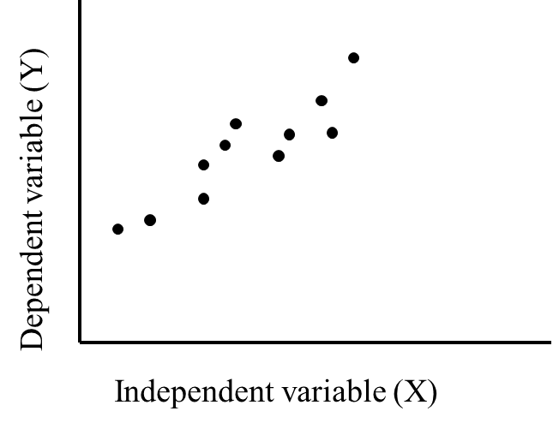
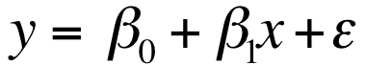
Linear Regression Analysis
Regression analysis is used to predict the value of one variable (the dependent variable) on the basis of other variables (the independent variables).
Dependent variable: denoted Y
Independent variables: denoted X₁, X₂, …, X_{k}
If we have only one independent variable then model will look like
which is referred to as simple linear regression. We would be interested in estimating β₀ and β₁ from the data we collect.
Regression.R

Slide 13
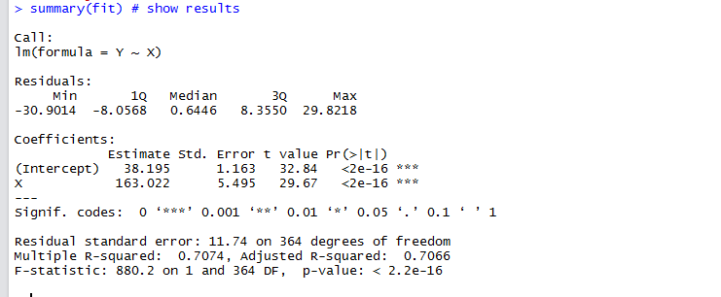
Interpreting the output
No. | Name
1 | Formula
2 | Residuals
3 | Estimated Coefficient
4 | Standard Error of #3
5 | t-value of #3
6 | Variable p-value
7 | Significance Stars
8 | Significance Legend
9 | Residual Std Error / Degrees of Freedom
11 | R-squared
11 | F-statistic & p-value
1
2
3
4
5
6
7
8
9
10
11

Slide 14
Interpreting the output
No. | Name | Description
1 | Model | Regression model formula
2 | Residuals | The residuals are the difference between the actual values of the variable you're predicting and predicted values from your regression
3 | Estimated Coefficient | The estimated coefficient is the value of slope calculated by the regression.
4 | Standard Error of #3 | Measure of the variability in the estimate for the coefficient.
5 | t-value of #3 | Score that measures whether or not the coefficient for this variable is meaningful for the model. t-value is used to calculate p-value and the significance levels.
6 | Variable p-value | Probability the variable is NOT relevant. This number to be as small as possible
7 | Significance Stars | The stars are shorthand for significance levels, with the number of asterisks displayed according to the p-value computed. *** for high significance and * for low significance.
8 | Significance Legend | The more punctuation there is next to your variables, the better. Blank=bad, Dots=pretty good, Stars=good, More Stars=very good
9 | Residual Std Error / Degrees of Freedom | Residual Std Error / Degrees of Freedom. The Degrees of Freedom is the difference between the number of observations included in your training sample and the number of variables used in your model (intercept counts as a variable).
11 | R-squared | Metric for evaluating the goodness of fit of your model.
11 | F-statistic & p-value | Performs an F-test on the model. This takes the parameters of our model (in our case we only have 1) and compares it to a model that has fewer parameters. The DF, or degrees of freedom, pertains to how many variables are in the model. In our case there is one variable so there is one degree of freedom.

Slide 15
Regression Analysis

Slide 16
Checking the validity of the linear model
plot(fit)
Residuals vs. fitted: Look for spread around the line y = 0 and no obvious trend.
Normal Q-Q plot(Quantile-Quantile): The residuals are normal if this graph falls close to a straight line.
Scale-Location plot shows the square root of the standardized residuals. The tallest points, are the largest residuals.
Cook's distance plot identifies points which have a lot of influence in the regression line.
Residuals vs. leverages plot shows observations with potentially high influence
Cook's distances vs. leverage/(1-leverage)

Slide 17
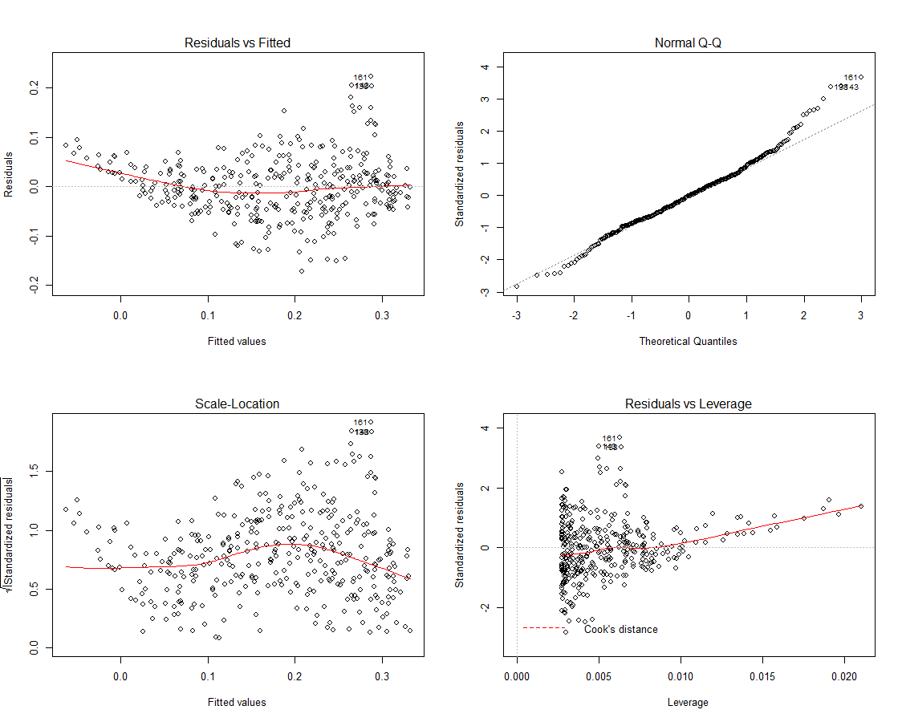

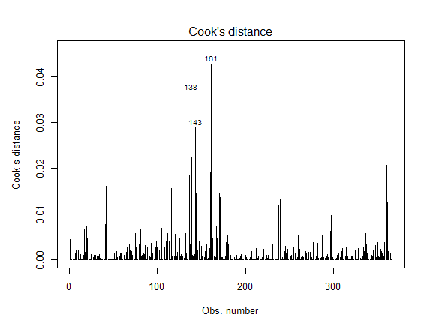

Slide 18
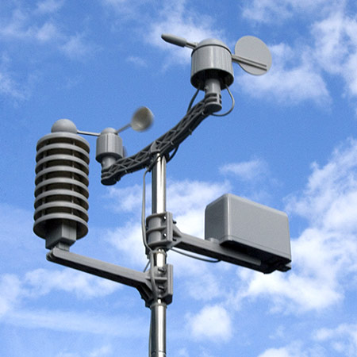
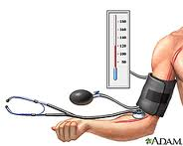
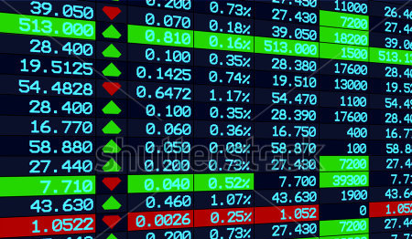
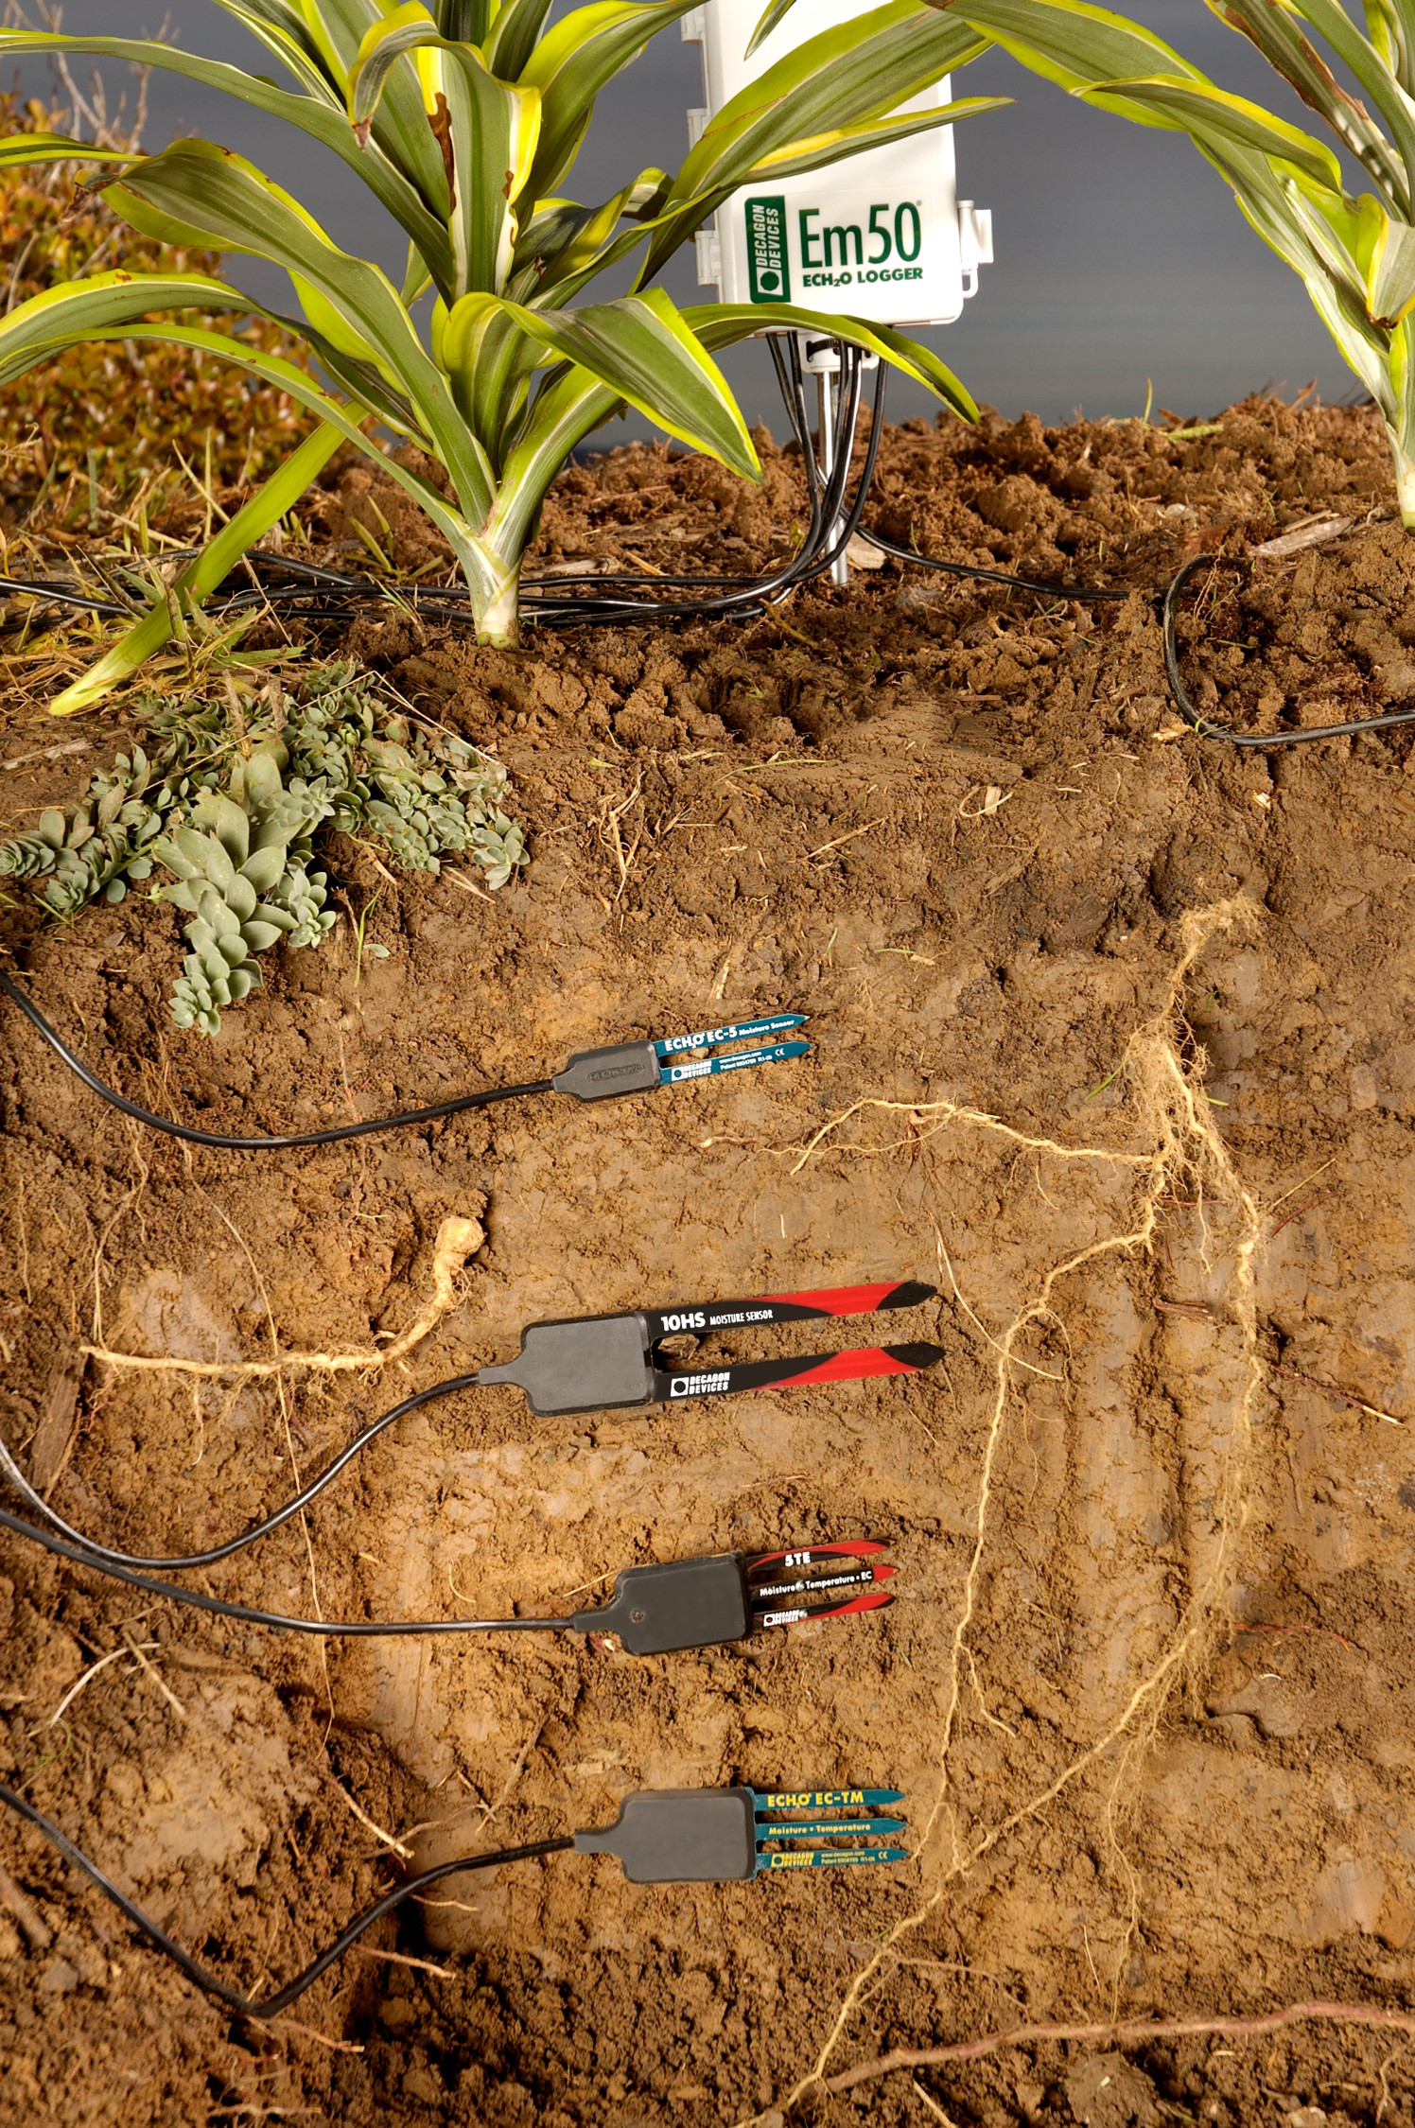
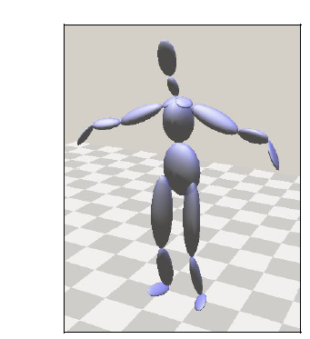
Time Series Examples
Definition: A sequence of measurements over time
Biology
Meteorology
Finance
Social science
Epidemiology
Medicine
Speech
Geophysics
Seismology
Robotics

Slide 19
Seasonal and Trend decomposition using Loess
STL is a very versatile and robust method for decomposing time series.
STL is an acronym for “Seasonal and Trend decomposition using Loess”, while Loess is a method for estimating nonlinear relationships.
The STL method was developed by Cleveland et al. (1990)
TrendAnalysis.R
TimeSeriesDemo.R

Slide 20
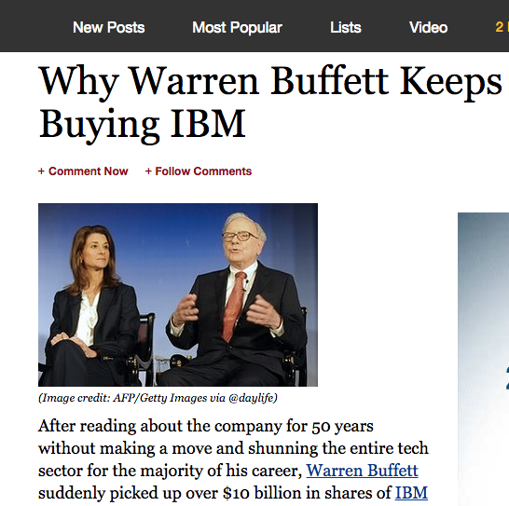
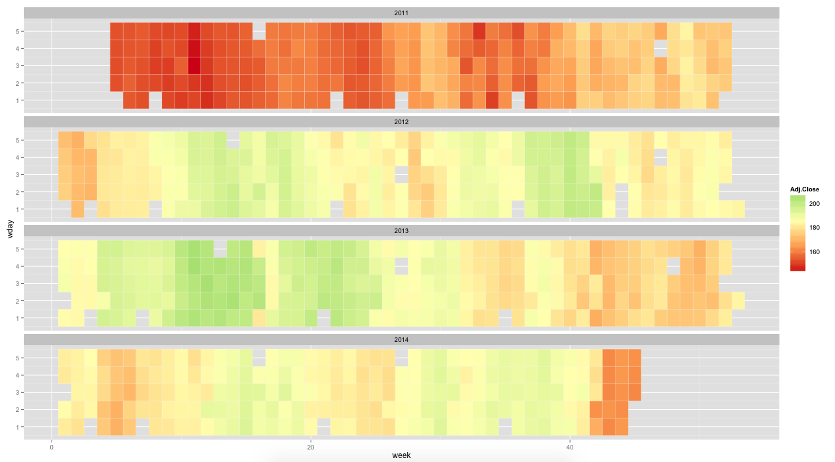
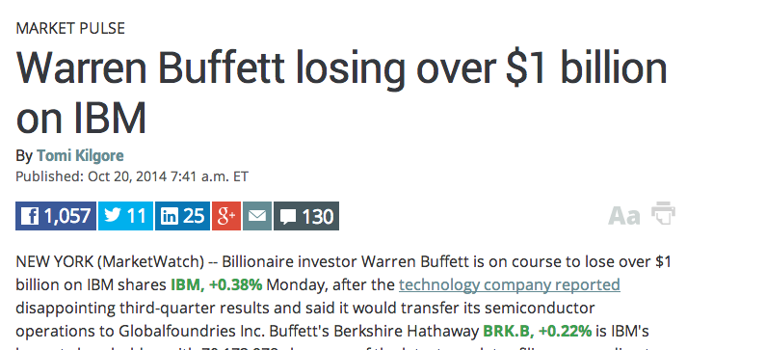
WHY?
HOW?
How to apply this in presentation?
http://www.forbes.com/sites/gurufocus/2013/01/08/why-warren-buffett-keeps-buying-ibm/
HeatMap.R
http://www.marketwatch.com/story/warren-buffett-losing-over-1-billion-on-ibm-2014-10-20

Slide 21


